Slide 1
Can’t Judge a Powder By Its Color
Gretchen S. Wolf
Continuing Lecturer
Purdue University Calumet
Site Coordinator Purdue Regional Science Olympiad
Regional Judge, 1999 to present
National Judge, 2003 Columbus, Ohio
2001 Colorado Springs, CO

Slide 2
Breakdown of Events
http://www.soinc.org/
SCIENCE OLYMPIAD EVENTS are distributed among three broad goal areas of science education:
Science Concepts and Knowledge Can’t Judge a Powder Cell Biology Disease Detectives Forestry Fossils Meteorology Metric Estimation Picture This Polymer Detectives Qualitative Analysis Road Scholar Science of Fitness
Science Processes and Thinking Skills Chemistry Lab Designer Genes Dynamic Planet Experimental Design Physics Lab Practical Data Gathering Process Skills for Life-Sci. Remote Sensing Science Crime Busters Storm The Castle Water Quality Write It-Do It
Science Application and Technology Astronomy Bottle Rocket Bridge Building Mission Possible Naked Egg Drop Reach for the Stars Robo-Billiards Robot Ramble Sounds of Music Tower Building Wheeled Vehicle Wright Stuff

Slide 3
Can’t Judge a Powder by Its Color
A team of up to 2 students
50 minutes time
Subdivided
25-35 minutes for testing
Students might want to think about working individually
25-30 minutes for questions
2004 changes noted in red
No flame testing will be done

Slide 4
Safety in the Laboratory
Students must bring and wear:
Aprons or lab coats
OSHA approved splash goggles with indirect vents.
No tasting
Or touching of powders is allowed
No open toed shoes may be worn

Slide 5
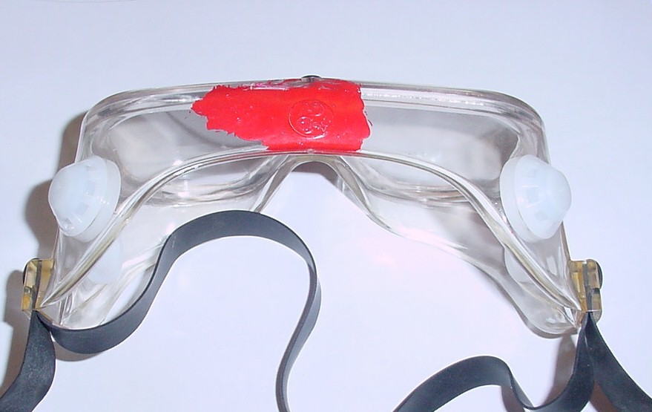
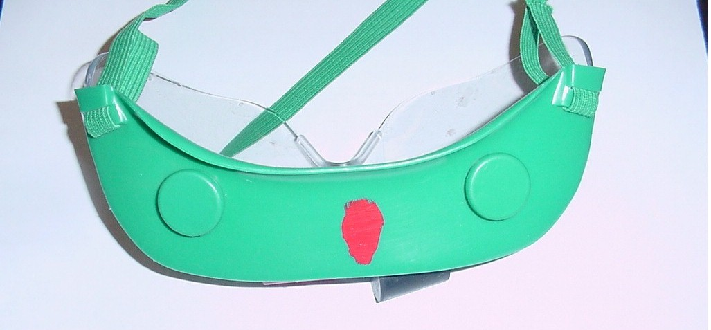
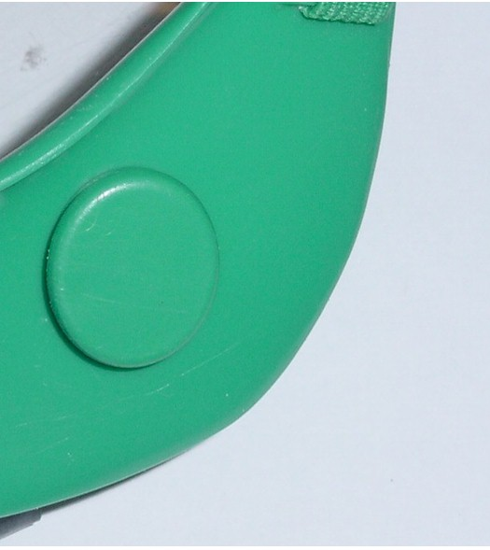
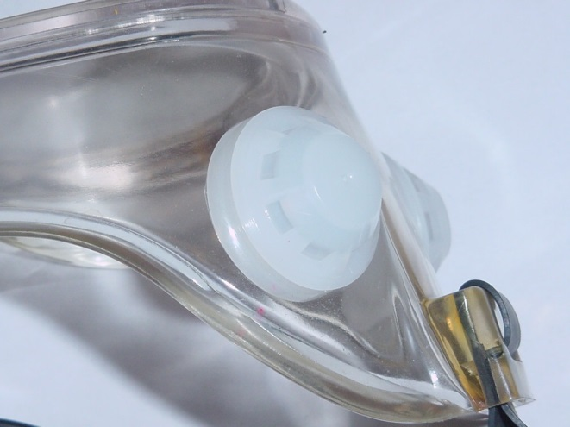
Safety Goggles

Slide 6
Students must provide:
pHydrion paper
Hand lens
Conductivity tester must be 9V no testers will be allowed to run on 120 volts
Beral pipettes or eye droppers
Test tube rack or holder if using test tubes

Slide 7
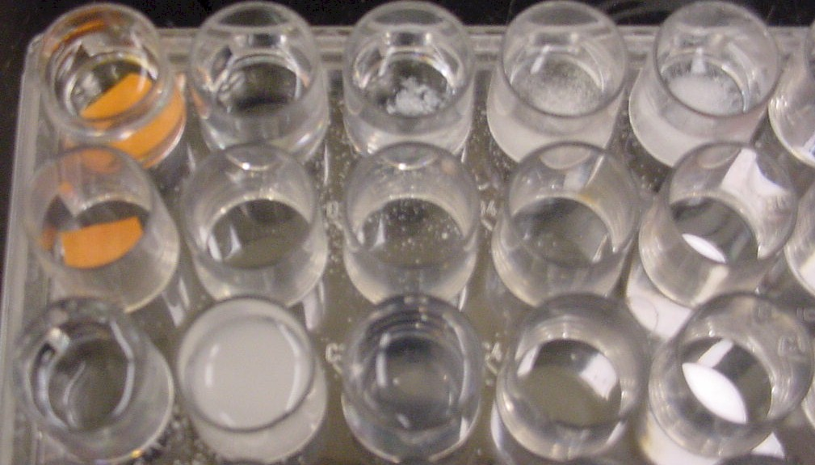
Students must provide:
Containers appropriate for testing conductivities, solubility, etc.
One or two 50 or 100 mL beakers
Size should be made compatible with the amount of powder a student will be using
Clear plastic spot plate
Nunclon ΔMultidishes and OmniTray
NNI # 12-565-75

Slide 8
Students must provide:
Spatula
Stirring Rod
Gloves are optional
NOTE:
The team may bring no other items. Supervisors will check the equipment and have the right to disqualify a team for using equipment not on this list.

Slide 9
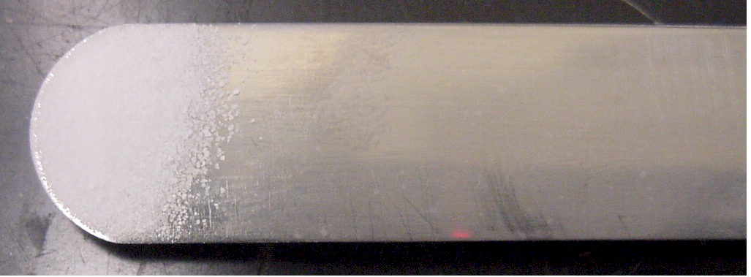
Spatulas
Fisher Cat# 14-365B
Normal spatula found in most labs

Slide 10
Spatulas
Micro Spatula
Hayman style
Fisher #21-401-25B
Type used for testing at Purdue

Slide 11
Conductivity Tester
Parts:
1 - LED (Light Emitting Diode) 1 - Resistor(330 ohm, 1/4 watt) 1 - 9 volt Transistor Radio Battery 1 - Battery Clip to fit Battery) 1 - 8 inch piece Red wire 1 - 8 inch piece Black wire 1 - 4 inch piece Black wire tape
http://www.soinc.org/condtstr.htm

Slide 12
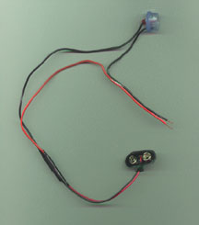
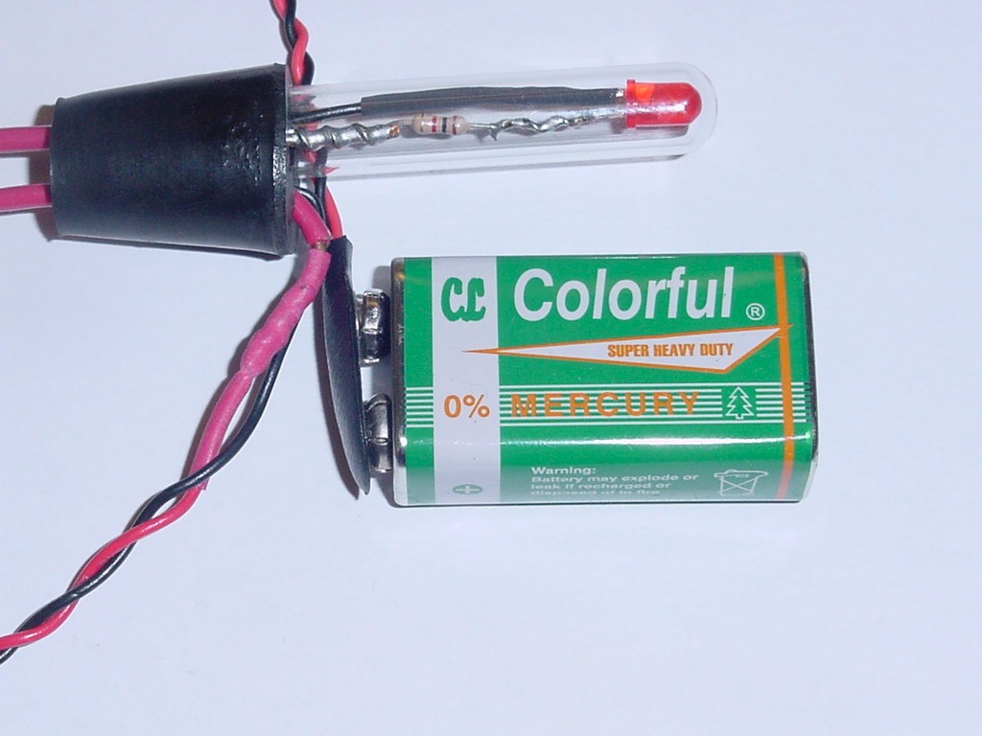
Conductivity Tester

Slide 13
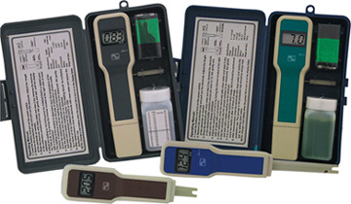
Conductivity Tester
Omega.com
CDH 5021 or 5022

Slide 14
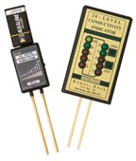
Conductivity Tester
Fishersci.com
10 level RCI junior
20 level RCI-Dx

Slide 15
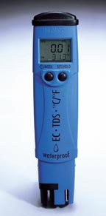
Conductivity Tester
Fishersci.com
DiST 5
DiST 6

Slide 16
Event Leaders will provide
Definitely:
The white powder
Or a colored powder
Distilled water
1.0 M NaOH
1.0 M HCl
A blue or black pen
A pencil
May also provide:
Thermometer
Calculator
Balance
Hot plate
An observation sheet
Anything else the supervisor decides to distribute.

Slide 17
Event Leaders will announce
Whether refills of the solid will be provided
Whether there are any additional reagents and how to use them
Waste disposal rules
Clean up procedure

Slide 18
The water:
Buy distilled water from the store.
Not spring water
Use procedure to degas (boil).
Adding HCl or NaOH will change conductivity of water
All tests at Purdue Calumet done with D.I. (de ionized) water from our water tanks

Slide 19
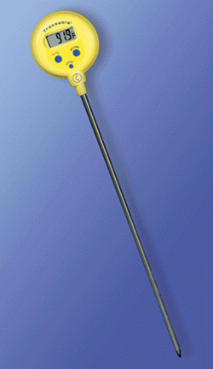
The Thermometer
Control Company
Cat. No. 4378
Traceable Lollipop Thermometer
Reads in both ºF and ºC
Be sure students use ºC
Or a spirit thermometer

Slide 20
Neutralizing Distilled Water
2003-04 will be provided event leader
http://www.ncsu.edu/science_olympiad/leaderinfo/neutralizewater.html
Boiling:
This is accomplished by boiling the water for 5-10 min. Fill a tightly stoppered bottle with the hot water.
Once the water is placed in the student’s bottle it begins to take up CO₂.

Slide 21
Flow Chart

Slide 22
Observation Sheet

Slide 23
Consistency
Encourage your students to be consistent with:
The size of the sample
The volume of water or any other liquid added
Perhaps, the container for testing

Slide 24
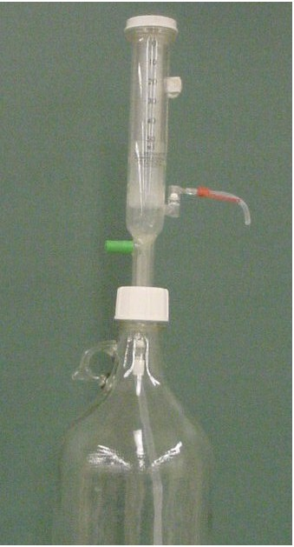
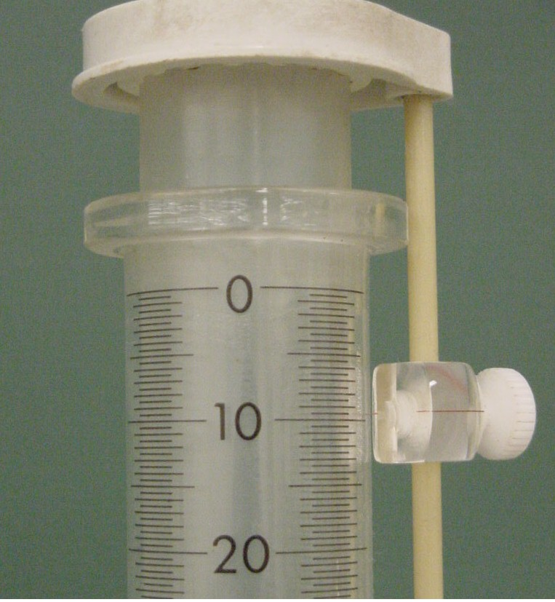
A way to dispense liquids
Dropper bottles
Empty soap dispenser
Small graduated cylinder

Slide 25
Proper usage of pH paper
pH hydronium paper
Cut into small pieces that will fit into container for testing

Slide 26
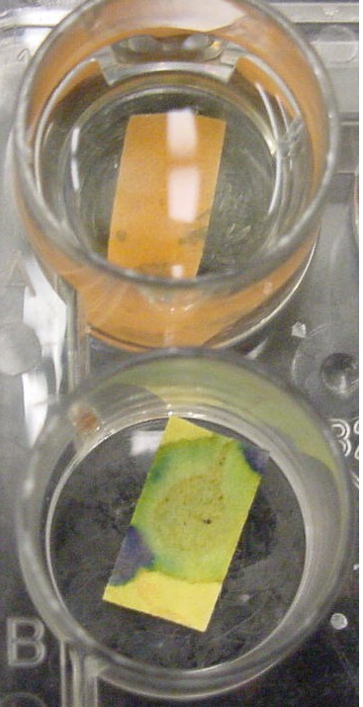
Proper Usage of pH paper
Do not place pH paper in a solution
Use the tip of a stirring rod to spot a small piece of pH paper
Read pH immediately

Slide 27
Flow Chart for testing sample

Slide 28
Testing Various Powders
Across each spot plate
Water, 1M HCl, 1M NaOH, 2-propanol(isopropyl alcohol), methanol
Second row: pH paper
Third row: 2 drops Ca(NO₃)₂
2 drops Ba(NO₃)₂
2 drops AgNO₃

Slide 29
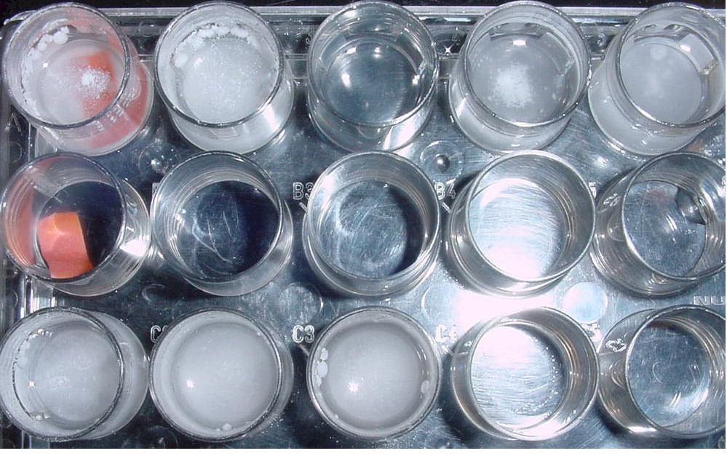
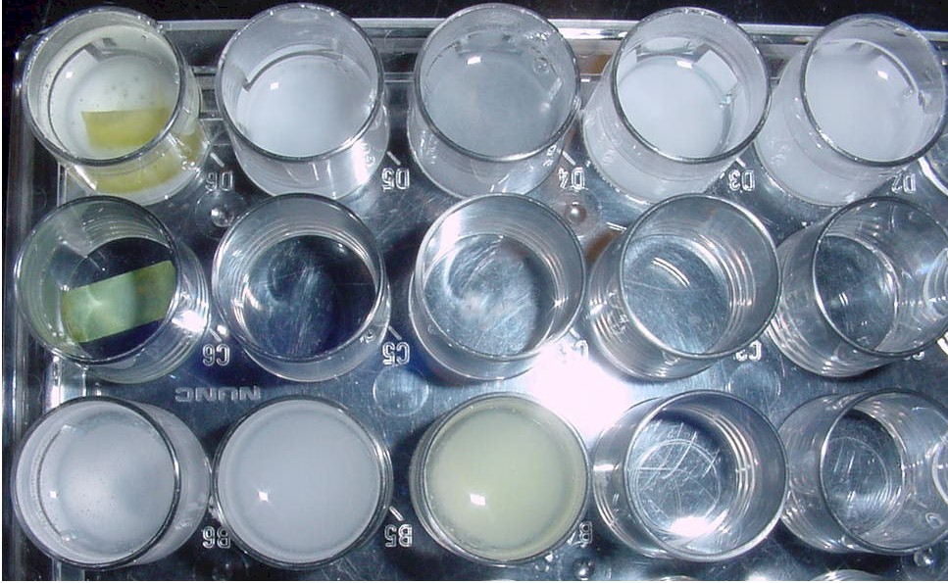
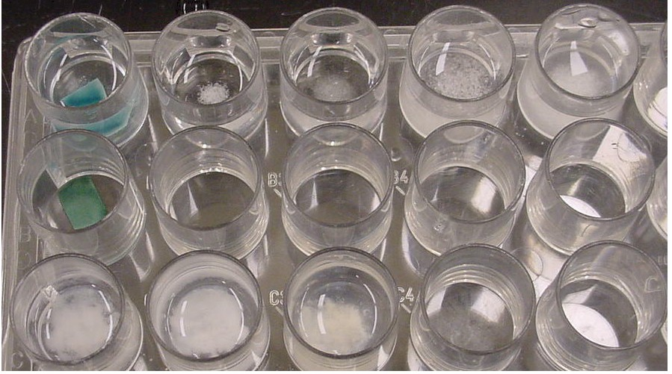
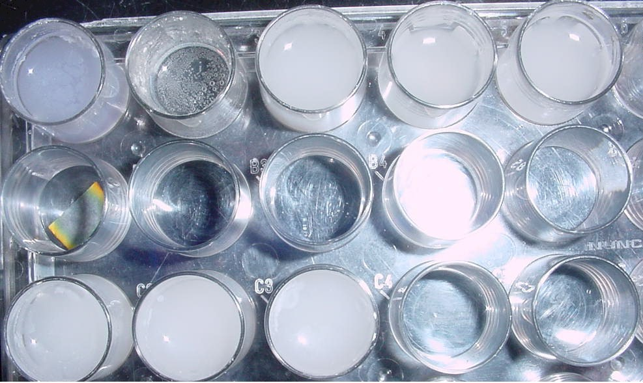
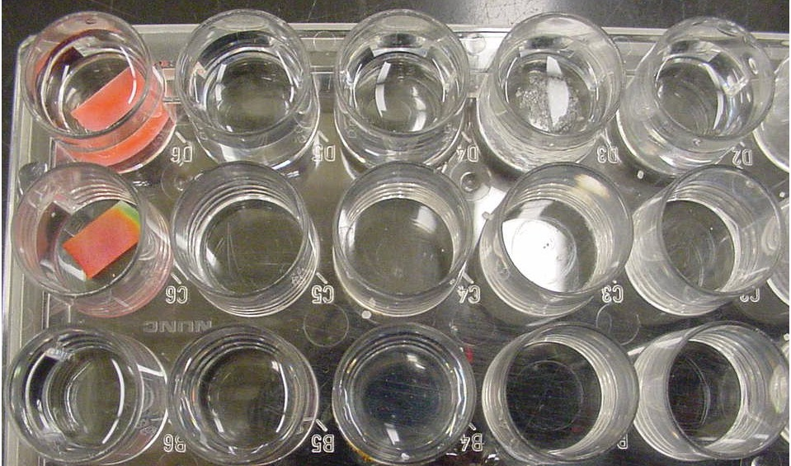
Testing Various White Powders
Alum
Aspirin
Baking Powder
Borax
Chalk
Citric acid

Slide 30
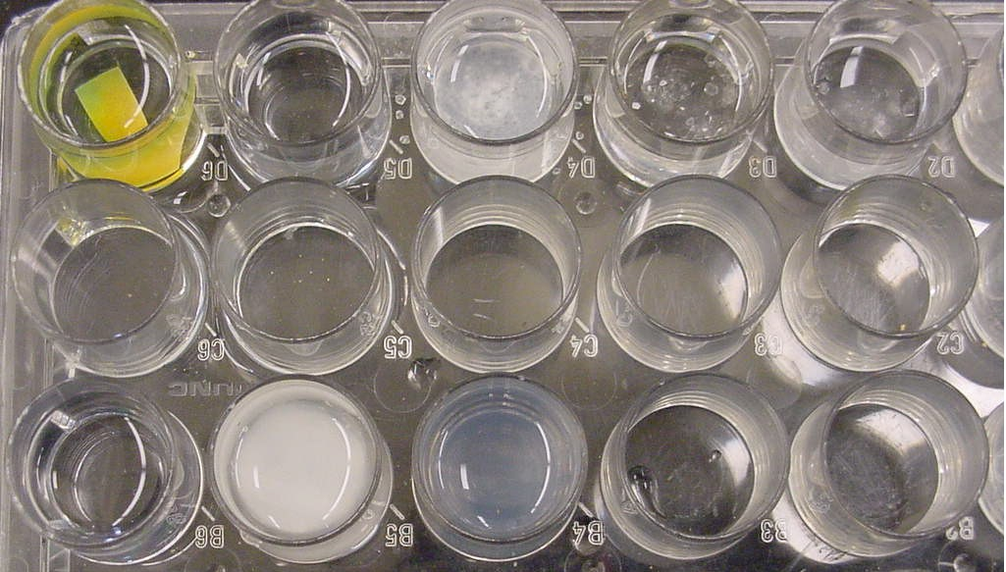
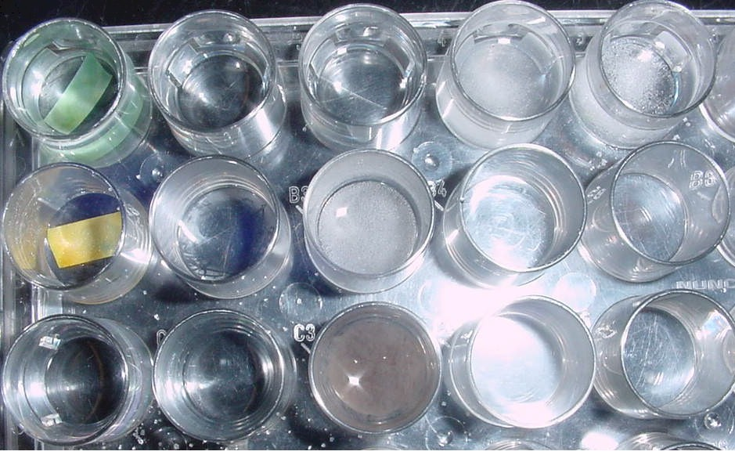
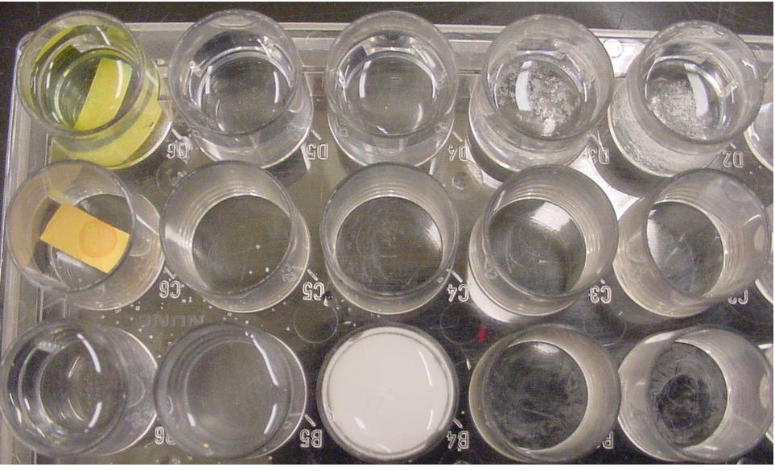
Testing Various White Powders
Epsom Salt
Sugar
Table salt

Slide 31
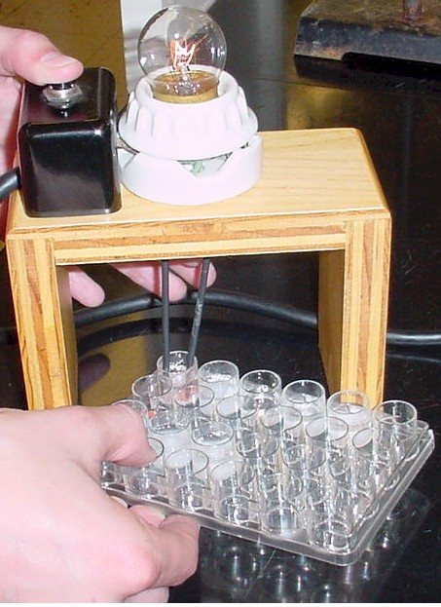
Conductivities
A solution showing conductivity
A solution showing little conductivity

Slide 32
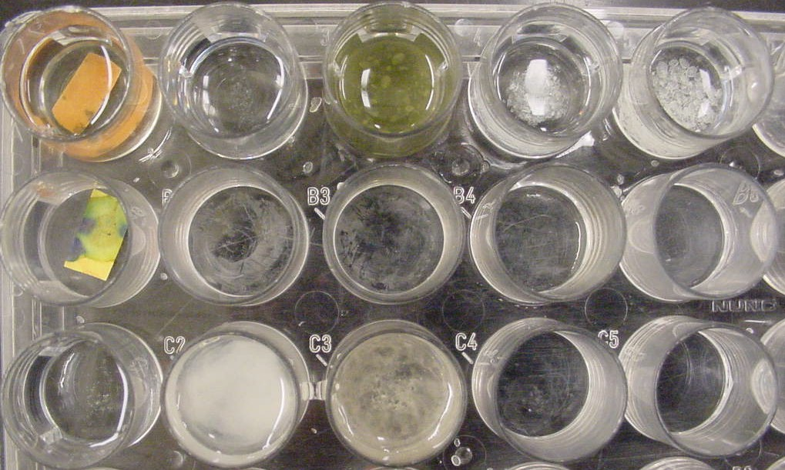
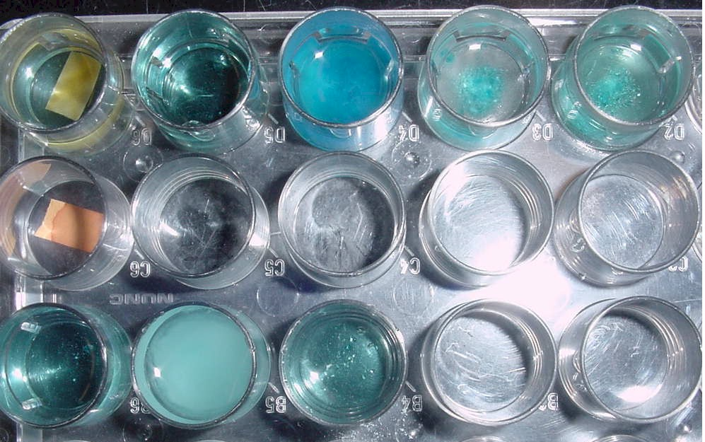
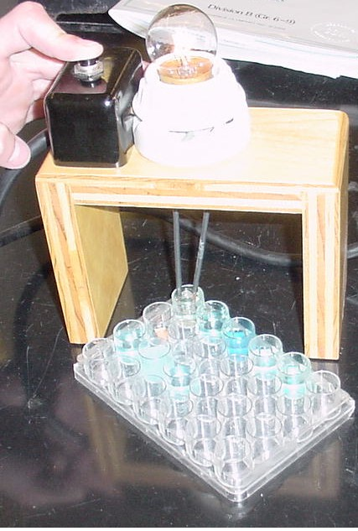
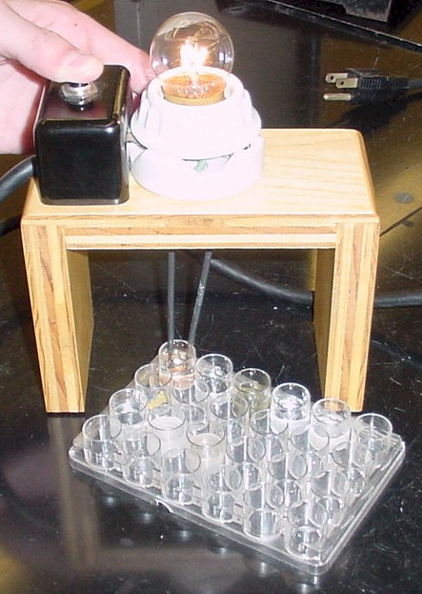
Testing Various Colored Powders
Copper sulfate
Ferrous ammonium sulfate

Slide 33
Summarizing:

Slide 34
Scoring the Event
The judge:
will collect the samples and the pens.
issue pencils.
provide the students with the questions
Students will be told:
to write and circle the question number in the column on the right hand side of the observation sheet
Any remembered answers are to be written below the observations written in pen. The question number should be written and circled in the right hand column as before.

Slide 35
Potential Questions:
What do the crystals look like?
Are they:
colored,
white,
clear?
Definition of hygroscopic:
A substance having a tendency to absorb water from the atmosphere and become damp, but not form a solution
Do the crystals seem to absorb water from the air?
Or, were the crystals hygroscopic?

Slide 36
Potential Questions:
Density:
D = m/v
Using a graduated cylinder:
The judge would have to provide a balance
What is the calculated density of the solid?
Some potential thought questions: The students would probably answer these as additional questions.
How many grams would 2mL of the solid weigh?
How many mL would 3 grams occupy

Slide 37
Potential Questions:
Density cont:
Relative density using a solvent:
Does the solid sink or float in the solvent supplied by the judge?
Is the solid more or less dense than the solvent supplied by the judge?
Potential solvents:
Hexane d = 0.6591
Methanol d = 0.8100 wood alcohol, methyl alcohol
Ligroin d = 0.850- 0.870 painter’s naphtha

Slide 38
Potential Questions:
Solubility
Definition: The mass of a solid substance that can be dissolved in 100 g. of solvent to form a saturated solution.
Most ionic compounds are soluble in water by undergoing the process of solvation.
Most covalent compounds will not be soluble in water.

Slide 39
Potential Questions:
Solubility
Is the substance soluble, totally, partially, little, or not soluble?
Is the substance soluble in the extra solvent the judge provided?
Is the substance more or less soluble in either HCl or NaOH than it was in water?

Slide 40
Potential Questions:
Temperature Change: The judge would have to provide a thermometer
This must be done only with the aqueous solution
Need a larger sample size to obtain measurable results
Definitions:
Exothermic: a reaction that gives out heat to its surroundings, ΔH is negative, because the system loses heat.
Endothermic: a reaction that takes in heat from its surroundings, ΔH is positive, because the system gains heat

Slide 41
Potential Questions:
Temperature Change: cont
What was the temperature of the water (before the powder was added)?
What was the temperature of the solution after the powder was added?
Did the temperature of the water increase or decrease when the powder was added?
What was the temperature change for the solution after the powder was added?
Was the process of dissolving endothermic or exothermic?

Slide 42
Potential Questions:
Conductivity:
The SI unit for conductivity is Siemens (S). The scales on various devices will vary. The most important property of a conductor is the amount of current it will carry when a voltage is applied. Conductance is the inverse of resistance.
Conductance = S= 1/ohm.
Electrolyte: Any compound which in solution conducts electric current. The solvent is usually water. Adjectives to describe electrolytes include: strong, weak, non.
Always test the solution of the powder in water (aqueous solution).
Do not test powder with NaOH or HCl.

Slide 43
Potential Questions:
Conductivity: cont
Did the aqueous solution conduct electricity?
Was the aqueous solution a strong, weak or non electrolyte?

Slide 44
Potential Questions:
pH of the solution
Only test aqueous solution
Correct use of pH paper
Definitions:
Acidic solutions have a pH <7
Basic solutions have a pH >7
What is the pH of the aqueous solution?
Was the aqueous solution acidic or basic?

Slide 45
Potential Questions:
Reaction with HCl or NaOH:
Is there any gas produced?
What is the odor of any gas?
Is there any color change?
Is there any precipitate formed?
Is the substance more or less soluble in either HCl or NaOH than it was in water?

Slide 46
Potential Questions with other reagents
Test solubility of powder in other reagents supplied.
Judge should indicate which reagent to use if there is more than 1 reagent
Is the substance soluble in the extra solvent the judge provided?
What might this indicate about the bonding in the powder?

Slide 47
Potential Questions with other reagents
Test for precipitate formation with addition a precipitation reagent
Judge should indicate reagent, if more than one reagent is available
Judge should tell students how much reagent to add

Slide 48
Potential Questions with other reagents
Test for precipitate formation, cont.
A solid formed from substances in solution.
Was a precipitate formed?
What color was the precipitate?
What was the form of the precipitate?
Was it a powder?
Or did it seem like jello?

Slide 49
How many questions?
Question sheet can also function as the scoring sheet.
10-12 seems to be a good number.
Give students the opportunity to note what they think is their best observation.
A question grading waste disposal and clean up of work area.

Slide 50
Question Sheet

Slide 51
Thoughts: Practice, Practice, Practice
Use common solids
Size of sample
Supply water in a wash bottle
Is temperature worth it?

Slide 52
Thoughts:
Perhaps supply a third liquid to test solubility
Perhaps supply a test reagent solution to look for precipitates
For #5 and #6 decide about waste problems
Is it worth is it?

Slide 53
Thoughts:
Where is waste from the students work to be disposed?
What about clean up of work area?
If judging decide on a powder and become familiar with that powder

Slide 54
In closing:
Can’t Judge a Powder
Gretchen Wolf may be contacted at:
Purdue University Calumet
GSWolf@calumet.purdue.edu
Or 219-989-2282
This presentation is available at the following web site.
http://www.calumet.purdue.edu/chemphys/olympiad/
Many thanks for this opportunity.
©Gretchen S. Wolf 10/01/03

Slide 55
Flow chart for testing sample

